Slide 1
HQL (Hibernate Query Language)
Is Language belong to FramWork (Hibernate) to make it easy handle with Data base instead query for sql ,my sql and anthor

Slide 2
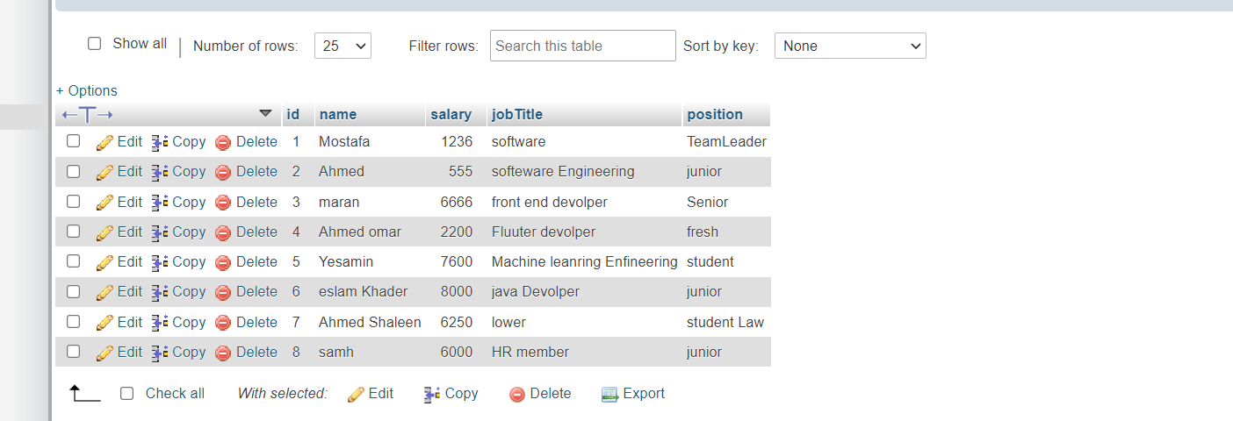
Operation with HQL and Possibilities
Frist this image the data base which worked in

Slide 3
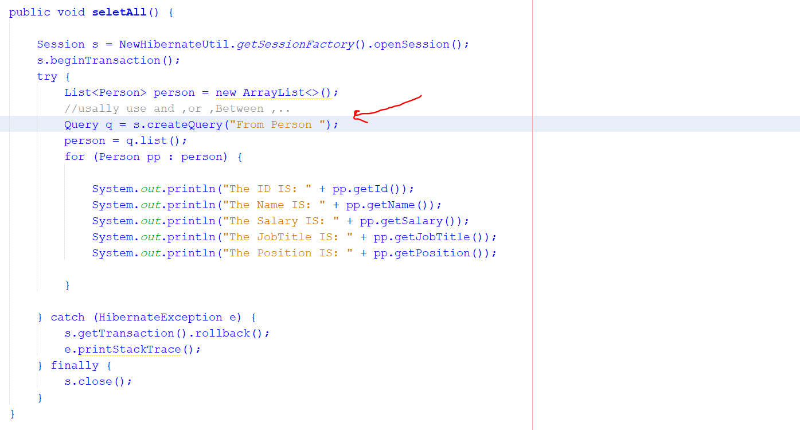
Select
Can select all Data in Data base with query code “From Classname” no table name
Such “From Person”
Code of Select Function

Slide 4
Session s = NewHibernateUtil.getSessionFactory().openSession();
s.beginTransaction();
This code creat session and open session wih Data base
catch (HibernateException e) {
s.getTransaction().rollback();
e.printStackTrace();
} finally {
s.close();
}
Catch error possible occur in session and Finsih session

Slide 5
List<Person> person = new ArrayList<>();
//usally use and ,or ,Between ,..
Query q = s.createQuery("From Person ");
person = q.list();
This query is Hql return all Data
And store in List and print this data
Code of print
for (Person pp : person) {
System.out.println("The ID IS: " + pp.getId());
System.out.println("The Name IS: " + pp.getName());
System.out.println("The Salary IS: " + pp.getSalary());
System.out.println("The JobTitle IS: " + pp.getJobTitle());
System.out.println("The Position IS: " + pp.getPosition());
}

Slide 6
output of Data
The ID IS: 1
The Name IS: Mostafa
The Salary IS: 1236
The JobTitle IS: software
The Position IS: TeamLeader
The ID IS: 2
The Name IS: Ahmed
The Salary IS: 555
The JobTitle IS: softeware Engineering
The Position IS: junior
The ID IS: 3
The Name IS: maran
The Salary IS: 6666
The JobTitle IS: front end devolper
The Position IS: Senior
The ID IS: 4
The Name IS: Ahmed omar
The Salary IS: 2200
The JobTitle IS: Fluuter devolper
The Position IS: fresh
The ID IS: 5

Slide 7
The Name IS: Yesamin
The Salary IS: 7600
The JobTitle IS: Machine leanring Enfineering
The Position IS: student
The ID IS: 6
The Name IS: eslam Khader
The Salary IS: 8000
The JobTitle IS: java Devolper
The Position IS: junior
The ID IS: 7
The Name IS: Ahmed Shaleen
The Salary IS: 6250
The JobTitle IS: lower
The Position IS: student Law
The ID IS: 8
The Name IS: samh
The Salary IS: 6000
The JobTitle IS: HR member
The Position IS: junior

Slide 8
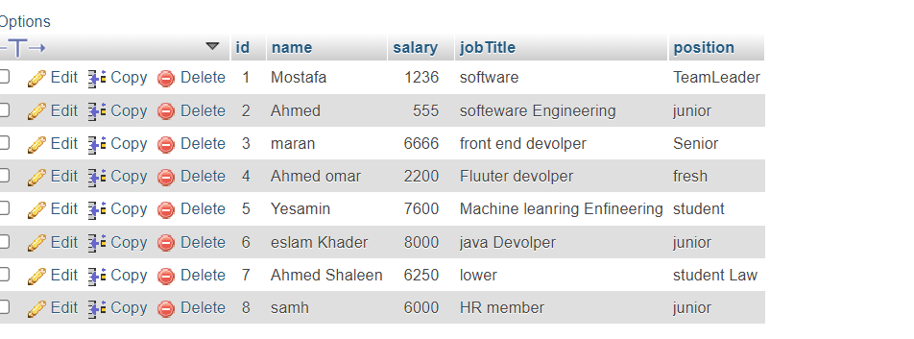
Can

Slide 9
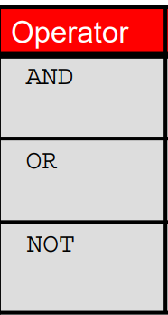
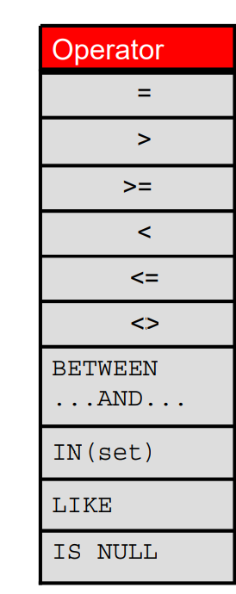
Can USE Comparison Operators and Logical Operators in HQL

Slide 10
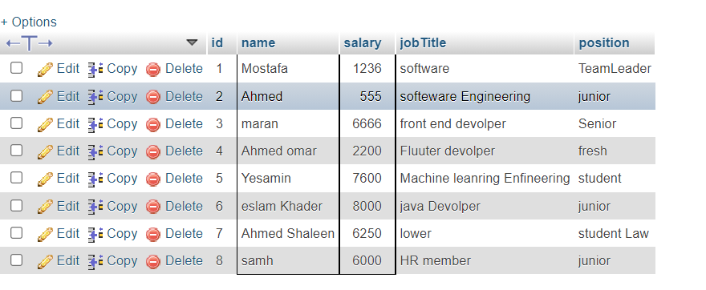
SUCH AS
The OUTPUT

Slide 11
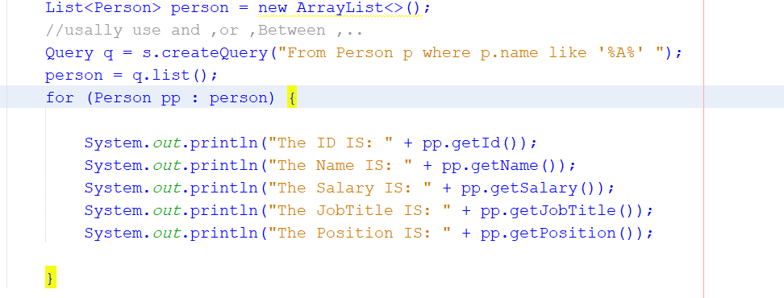
List<Person> person = new ArrayList<>();
//usally use and ,or ,Between ,..
Query q = s.createQuery("From Person p where p.name like '%A%' “ );
person = q.list();

Slide 12
Specifice vaule with HQl
Query q=session.createQuery("update Person set name=:n where id=:i");
q.setParameter("n","Udit Kumar");
q.setParameter("i",111);
q.setString("n","Udit Kumar“);
May use set String ,set intger
Query q=session.createQuery("update Person set name=? where id=?");
q.setString(0,”ali”); // index
q.setintger(1,1122); // use index

Slide 13
Example of HQL delete query
Query query=session.createQuery("delete from Person where id=100");
query.executeUpdate();

Slide 14
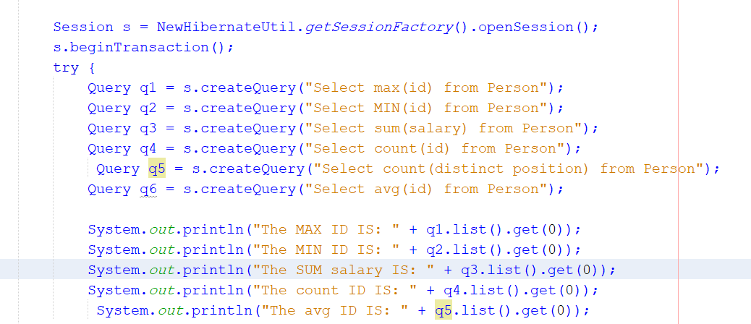
HQL with Aggregate functions

